Slide 1
Splenic preservation and indications for splenectomy Assa fcs senior registrars tutorial
Luvhengo Thifhelimbilu
16 January 2025

Slide 2
Key topics
Basic sciences.
Ligaments.
Splenic artery.
Accessory spleens.
Indications for splenectomy.
Trauma.
Non-trauma.
Splenic preservation: Trauma and non-trauma.

Slide 3
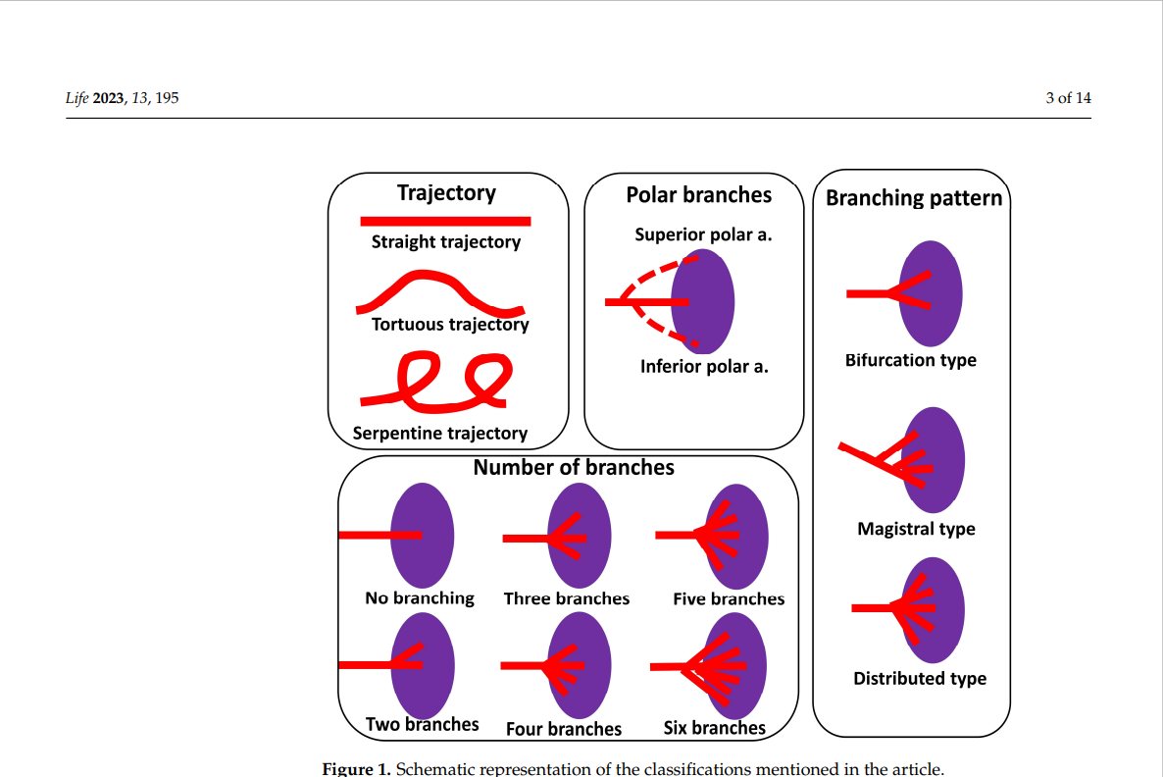
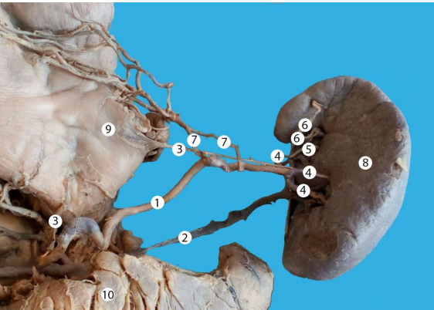
Variation of Anatomy of splenic artery

Slide 4
Splenic ligaments
Phrenicolineal.
Splenocolic.
Splenorenal.
Gastrosplenic.

Slide 5
Accessory spleen
Splenic hilum (75%).
Tail of pancreas.
Splenic ligaments.
Greater omentum.
Mesentry.

Slide 6
Surgical relevance of anatomy of splenic artery and ligaments
Iatrogenic injury during abdominal injury.
Splenectomy approach for trauma versus elective (posterior versus anterior approach).
Splenic preservation
Arterial embolization.
Partial or subtotal splenectomy.
Outcome of splenectomy for ITP.

Slide 7
Splenectomy

Slide 8
Absolute indications for splenectomy
Abscess.
Aneurysm of splenic artery.
Malignancy.
Trauma with haemodynamic instability.

Slide 9
Relative indications
Everything else is relative.

Slide 10
splenectomy for trauma
Resuscitation.
Assessment.
Imaging.
Assessment.
Serial monitoring.

Slide 11
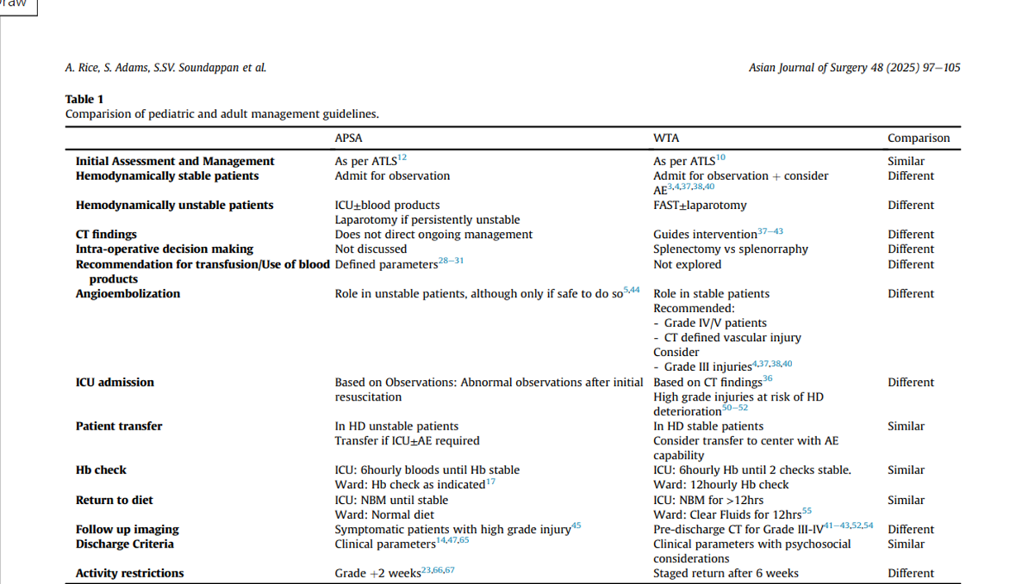

Slide 12
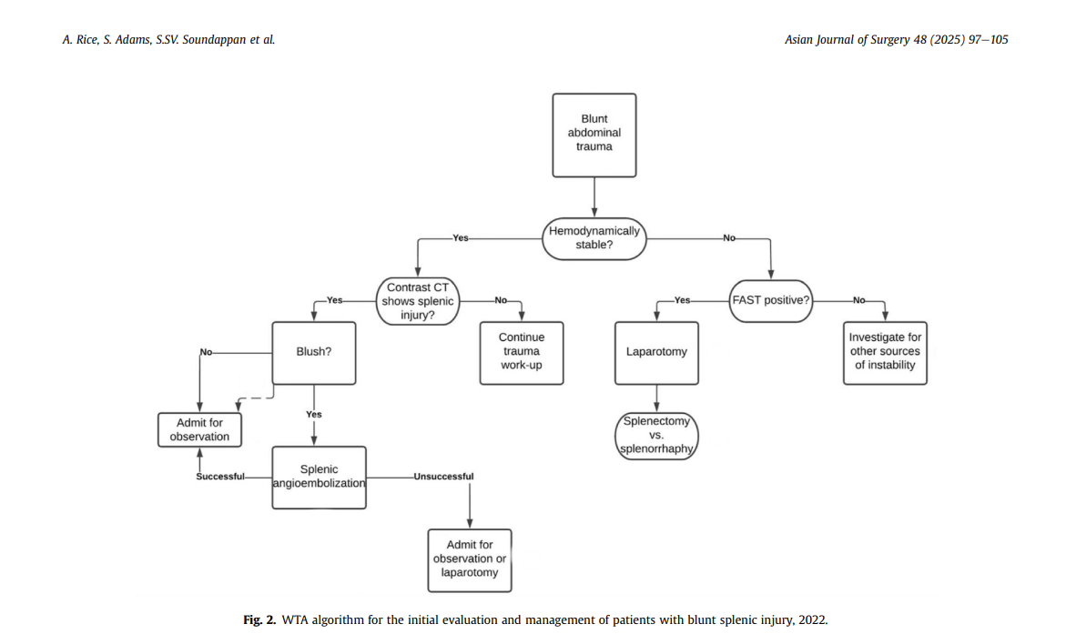

Slide 13
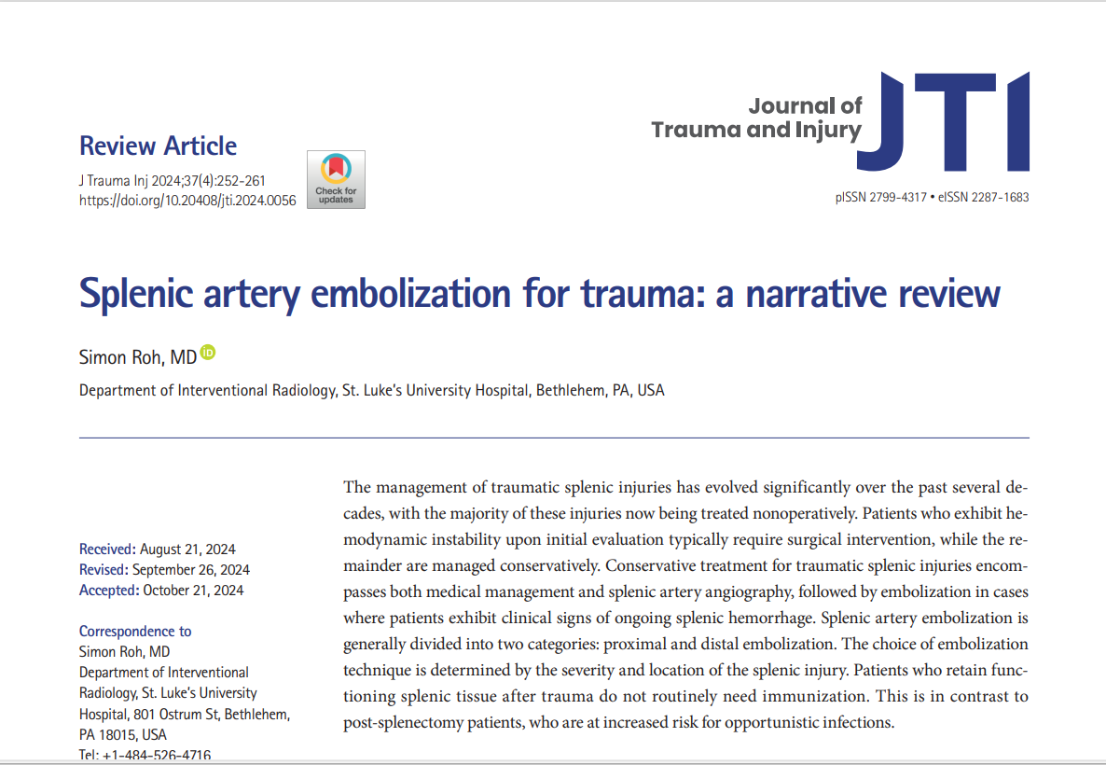

Slide 14
Conduct of splenectomy for trauma
Indication: persistent haemodynamic instability or associated injuries.
Posterior approach.
Aim for splenic preservation.
Timing of vaccination.
Antimicrobial prophylaxis.

Slide 15
Non-trauma indications for splenectomy.

Slide 16
Which of the following most appropriate indication for splenectomy?
Hereditary spherocytosis.
Idiopathic thrombocytopenic purpura.
Portal hypertension.
Sickle cell disease.

Slide 17
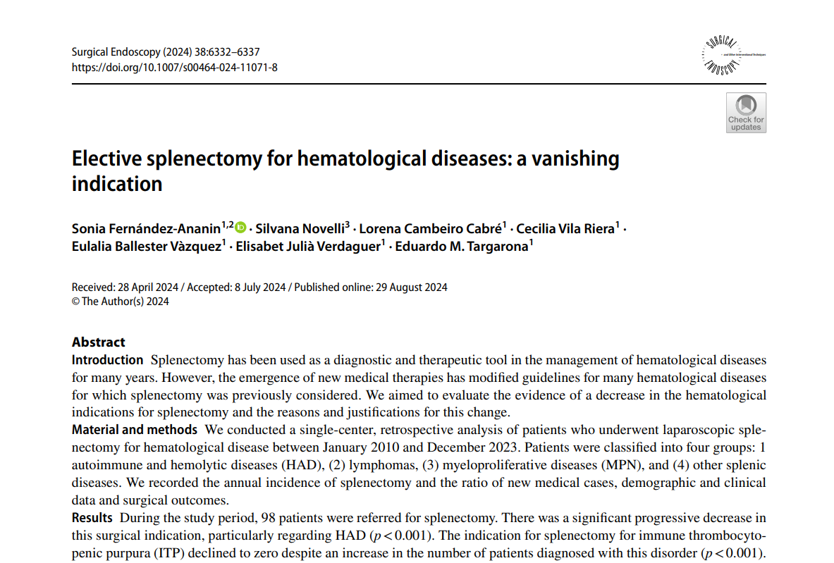

Slide 18
Peculiarity of Splenectomy for immune thrombocytopenic purpura
Rarely required unless if compliance with medical treatment is challenging.
Population: Children, adolescent and young adults and older adults.
Timing of splenectomy: After at least 12 months.
Steroid treatment continuation and vaccination.
Platelet transfusion: Not pre-operatively.
Vascular ligation: splenic artery first.
NB: No role for partial or subtotal splenectomy.

Slide 19
Outcome of splenectomy for ITP.

Slide 20
Splenectomy for portal hypertension
Summary: Don’t do it (except left-sided/sinistral portal hypertension).

Slide 21
Complications of splenectomy
Infective complications (including OPSI).
Porto-splenic vein thrombosis.
Thrombocytosis (when and how to respond).
Thromboembolic disease.
Pulmonary hypertension.

Slide 22
Overwhelming post splenectomy infection
Highest in the first year following splenectomy.
More following non-trauma cases (debatable).
Children are more at risk.
Higher in the first year but life-long with lifetime risk of around 5%.
Encapsulated organisms.
S. pneumonia, H. influenza, N. meningitides.
Influenza, Malaria and other infections.

Slide 23
A 10- year old girl has sore throat. It is associated with fever. She had splenectomy for trauma 6 months ago. Her GCS is 10/15, heart rate 120/min, blood pressure is 80/30 and temperature is 40 degree Celsius. Which one of the following would be the likely causative organism?
H. influenzae.
L. monocytogenes.
N. meningitides.
S. aureus.
S. pneumonia.

Slide 24
Prevention of overwhelming post-splenectomy infections
Avoiding splenectomy.
Splenic preservation.
Vaccination.
Prophylactic antibiotics.
High index of suspicion.
Timeous intervention.

Slide 25
Splenic preservation
Non-operative management.
Splenic artery embolization.
Splenorrhaphy.
Partial splenectomy.
Subtotal splenectomy.

Slide 26
Partial or subtotal splenectomy and embolization
Which one of the following would be the LEAST appropriate indication for partial, subtotal splenectomy or splenic artery embolization?
Grads IV splenic injury.
Haemagngioma.
Hereditary spherocytosis.
Idiopathic thrombocytopenic purpura.
Portal hypertension with hypersplenism.
Splenic metastasis.

Slide 27
Partial and subtotal splenectomy
Trauma or partial rupture.
Cysts (including hydatid cyst).
Haematolytic conditions.
Benign tumours.
Primary and metastatic conditions.

Slide 28
Trauma: vaccination Appropriate Time
When is the most appropriate time to administer polyvalent vaccines to prevent OPSI following splenectomy?
<12 hours.
12-24 hours.
25-36 hours.
37-48 hours.
>48 hours

Slide 29
Elective: appropriate time for administration of vaccine preoperative
When would be the most appropriate time to administer the first vaccination against S pneumonia, H influenza and N meningitides to a patient scheduled for elective splenectomy?
<1 week.
1 week.
2 weeks.
> 2 weeks.

Slide 30
Thank you.

