Slide 1









4th T TMAS
SYMPOSIUM
04 DECEMBER 2015
DEPARTMENT OF GENERAL SURGERY
LECTURE HALL S113
CLINICAL PATHOLOGY BUILDING
THEME: SPECTACULAR LAPAROSCOPIC CASES

Slide 2
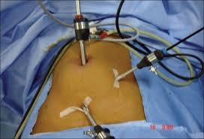
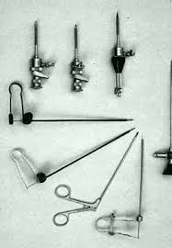
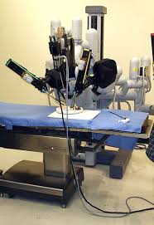
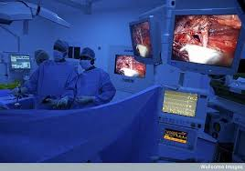
Workshop description
This is an intensive 1 day interactive symposium with very experienced faculty in laparoscopic surgery . Tricks of laparoscopic surgery are discussed in detail. This years theme is “Spectacular cases in laparoscopic surgery.”
Organised
The symposium is organised by the department of surgery division of minimal access surgery of the Sefako Makgatho Health Sciences University.
Objectives
The objective of the symposium is to provide a program where skills in laparoscopic surgery are shared. To avail experienced faculty to interact with the surgical community to highlight and share surgical pearls in minimal access surgery. The symposium seeks to advance the course of laparoscopic surgery in South Africa.
Sponsors
Main sponsor : Sefako Makgatho Health Sciences Department of General Surgery
Other sponsors: Karl Storz
Johnson & Johnson (Ethicon)
BARD
Systagenix
Convidien
Surgical Innovations
Clinix Health Group

Slide 3

“T O T MAS” Programme – 04 December 2015 Theme: Spectacular Laparoscopic Cases
Time | Topic | Presenter
07:15 - 07:50 | Registration
07:50 – 07:55 | Welcome of all delegates | HOD: Prof Koto
07:55 – 08:00 | Opening remarks | Director: School of Medicine: Prof N Ebrahim
 | Session 1: Miscellaneous – Video Session | Chairman: Dr A Mokhtari
08:00 – 08:10 | Laparoscopic Graham patch for a perforated peptic ulcer of an unusual site | Prof M Z Koto
08:10 – 08:15 | Discussion
08:15 – 08:25 | Laparoscopic management of chronic diaphragmatic hernia | Prof M Z Koto
08:25 – 08:30 | Discussion
08:30 – 08:40 | Laparoscopic TEP for the complex inguinal hernia | Dr Thendo Sumbana – Fellow in Colorectal Surgery
08:40 – 08:45 | Discussion
08:45 – 08:55 | Laparoscopic management of paprduodenal hernia – an unusual cause of bowel obstruction | Dr Martin Phakula – Fellow in Minimal Access Surgery
08:55 - 09:00 | Discussion
 | Session 2 : Miscellaneous – Video Session | Chairman: Prof F Ghoor
09:00 - 09:05 | Industry presentation
09:05 – 09:15 | Laparoscopic splenectomy – taking on all comers using the bare minimum | Dr O Osuagwu – Fellow in Minimal Access Surgery
09:15 – 09:20 | Discussion
09:20 – 09:30 | Laparoscopic esophagectomy | Dr O Osuagwu – Fellow in Minimal Access Surgery
09:30 – 09:35 | Discussion
09:35 – 09:45 | Laparoscopic adrenalectomy | Dr Martin Phakula – Fellow in Minimal Access Surgery
09:45 – 09:50 | Discussion
09:50 – 09:55 | Industry presentation
09:55 – 10:00 | Industry presentation
10:00 – 10:30 | TEA

Slide 4

“T O T MAS” Programme – 04 December 2015 Theme: Spectacular Laparoscopic Cases
10:00 – 10:30 | TEA | S103
 | Session 3 : Miscellaneous | Chairman: Dr M Govender
10:30 – 10:40 | Laparoscopic Whipple resection – where are we in South Africa | Dr M Govender
10:40 – 10:45 | Discussion
10:45 – 10:55 | Use of rigid uteroscopy in common bile duct exploration | Dr I Sardiwalla
10:55 – 11:00 | Discussion
11:00 – 11:10 | Paediatric thoracoscopic surgery | Prof M van Niekerk
11:10 – 11:15 | Discussion
11:15– 11:25 | Single incision paediatric minimal invasive surgery | Prof M van Niekerk
11:25 – 11:30 | Discussion
11:30 – 11:40 | Laparoscopic management of ruptured appendix with four quadrant pus | Dr Thendo Sumbana – Fellow in Colorectal Surgery
11:40 – 11:45 | Discussion
11:45 – 11:55 | Industry presentation
11:55 - 12:00 | Industry presentation
12:00 – 13:00 | LUNCH
 | Session 4 | Chairman: Prof Becker
13:00 – 13:10 | RFA for Barrets esophagus | Dr C Ziady
13:10 – 13:15 | Discussion
13:15 – 13:25 | ERCP for unusual case of obstructive jaundice | Dr C Ziady
13:25 – 13:30 | Discussion
13:30 – 13:40 |  | Dr C Ziady
13:40 – 13:45 | Discussion
13:45 – 13: 55 | Laparoscopy in penetrating abdominal trauma with organ evisceration – SMU experience | Dr O Y Matsevych
13:55 – 14:00 | Discussion

Slide 5
“T O T MAS” Programme – 04 December 2015 Theme: Spectacular Laparoscopic Cases
14:00 – 14:10 | Laparoscopy in penetrating trauma – SMU experience | Dr O Y Matsevych
14:10 – 14:15 | Discussion
 | Session 5 | Dr Sofianos
14:15 – 14:25 | Laparoscopy in perforated peptic ulcer – SMU experience | Dr S Makhadi – Surgical Registrar
14:25 – 14:30 | Discussion
14:30 – 14:40 | Laparoscopic distal pancreatectomy for a fractured pancreas from blunt trauma - video | Prof M Z Koto
14:40 – 14:45 | Discussion
14:45 – 14:50 | Industry
14:50 -14:55 | Industry
14:55 – 15:05 | Pyloroplasty and laparoscopy for highly selective vagotomy for intractable ulcer – video | Prof M Z Koto
15:05 – 15:10 | Discussion
15:10 – 15:40 | Ethics Lecture: Connecting the dots forward | Prof Becker
15:40 – 15:45 | Discussion
15:45 | Vote of thanks and closure

